Slide 2
MAREMA Real Estate Conference
Richmond, Virginia
October 23, 2015
Presenter:
Stephen M. Renna
President & CEO, CRE Finance Council

Slide 3
CRE Finance Council
CREFC is a trade association that is:
Dedicated exclusively to the commercial real estate finance industry.
Committed to promoting strong and liquid debt markets.
The meeting place for industry professionals.
The platform for establishing best practices, industry standards and federal policy.

Slide 4
U.S. Real Estate Investment Activity
Property Sales ($B)
10yr UST
Decade | Avg. | Med.
1962 - 1969 | 4.85% | 4.61%
1970 - 1979 | 7.50% | 7.50%
1980 - 1989 | 10.58% | 10.84%
1990 - 1999 | 6.65% | 6.50%
2000 - 2009 | 4.44% | 4.43%
2010 - 2014 | 2.57% | 2.76%
1998 – 2012 10yr UST
Avg. 4.22%
2003 – 2007 10yr UST
Avg. 4.40%
2014
Up 17% vs.
2013
2013
Up 21% vs.
2012
2012
Up 27% vs. 2011
2011
Up 59% vs. 2010
1Q15
Up 44% vs.
1Q14
2010
Up 114% vs. 2009
Down 88% From Peak
5.02% 4.61% 4.01% 4.27% 4.29% 4.80% 4.63% 3.66% 3.26% 3.22% 2 .78% 1.80% 2.35% 2.54% 2.72% 2.04%
Average Annual 10yr UST
Source: Real Capital Analytics

Slide 5
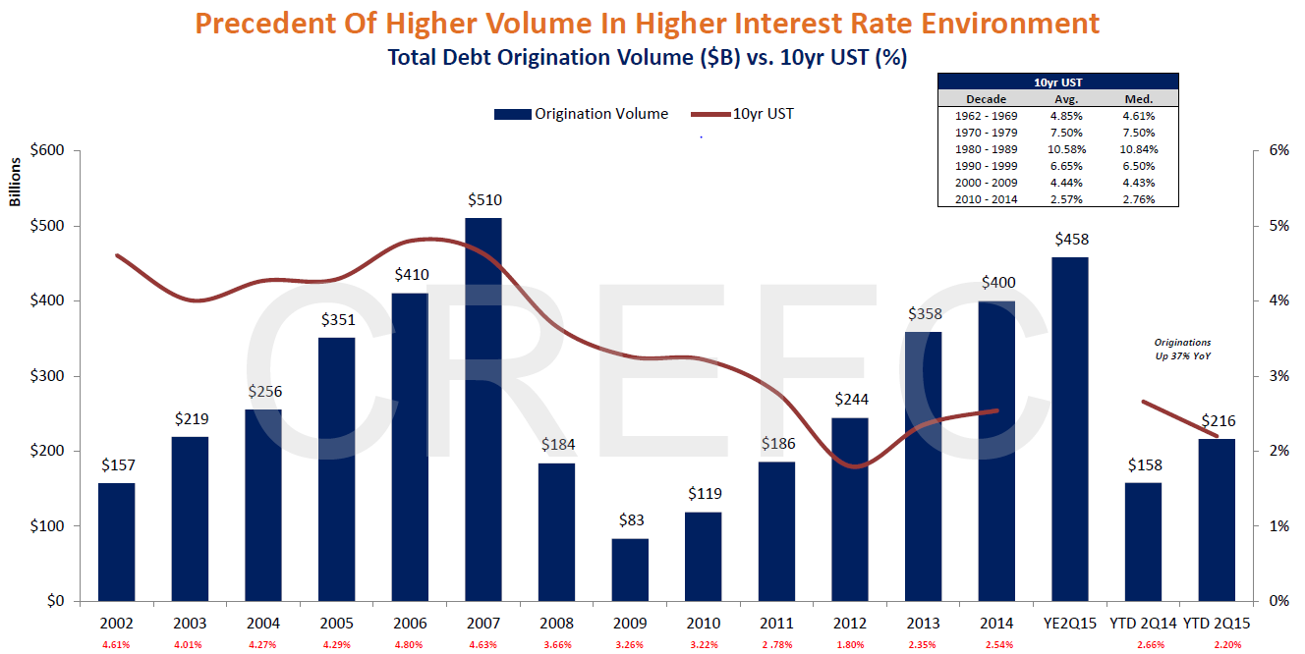
Source: Mortgage Bankers Association/Bloomberg via HFF

Slide 6
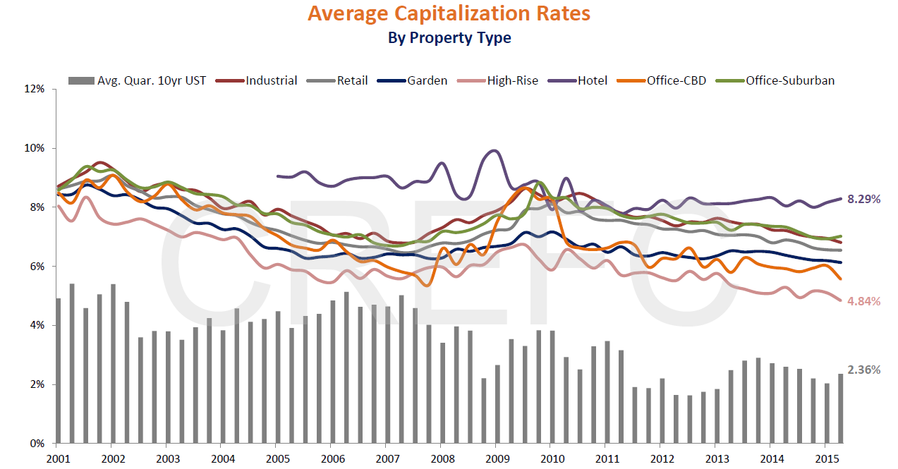
Source: Real Capital Analytics

Slide 7
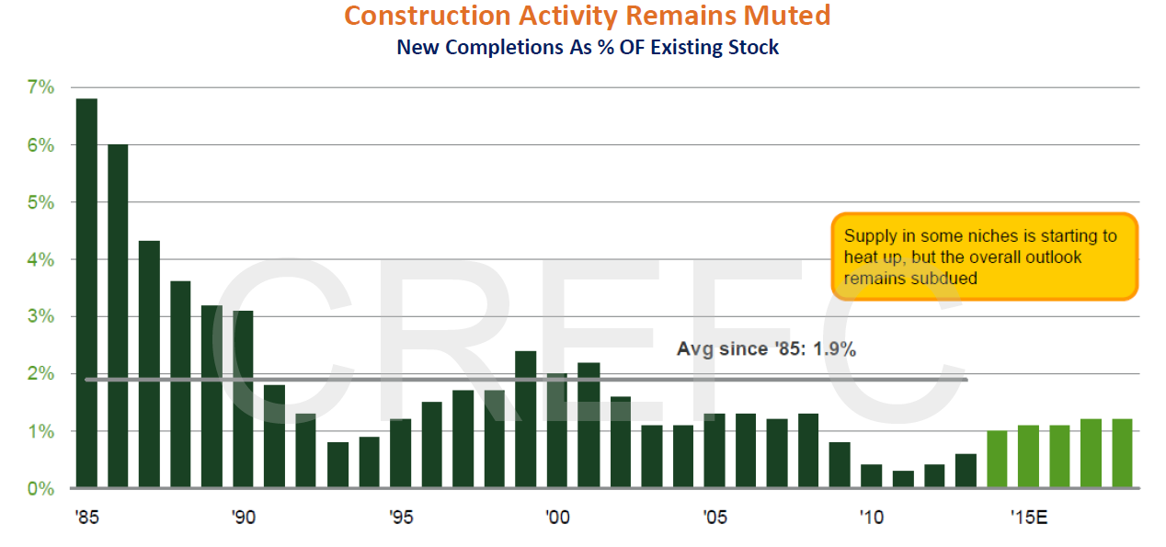
Source: Federal Reserve

Slide 8
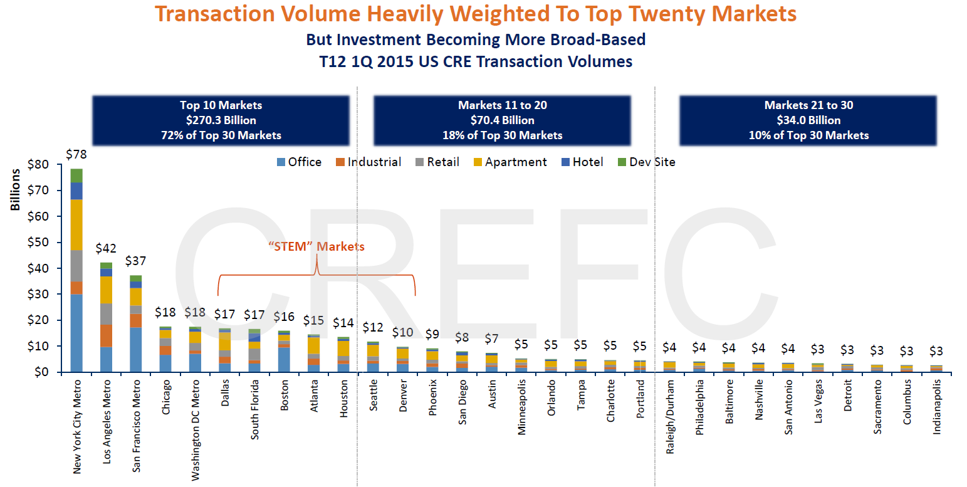
Source: Real Capital Analytics via HFF

Slide 9
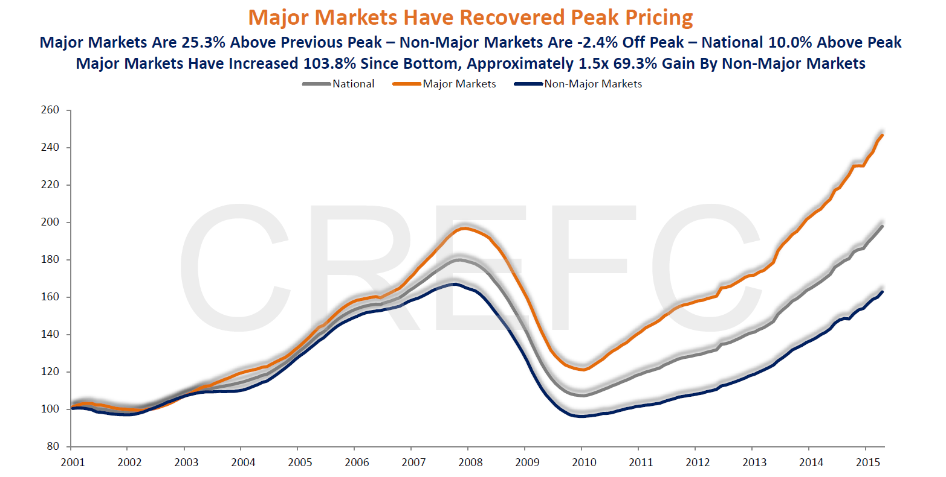
Source: Real Capital Analytics via HFF

Slide 10
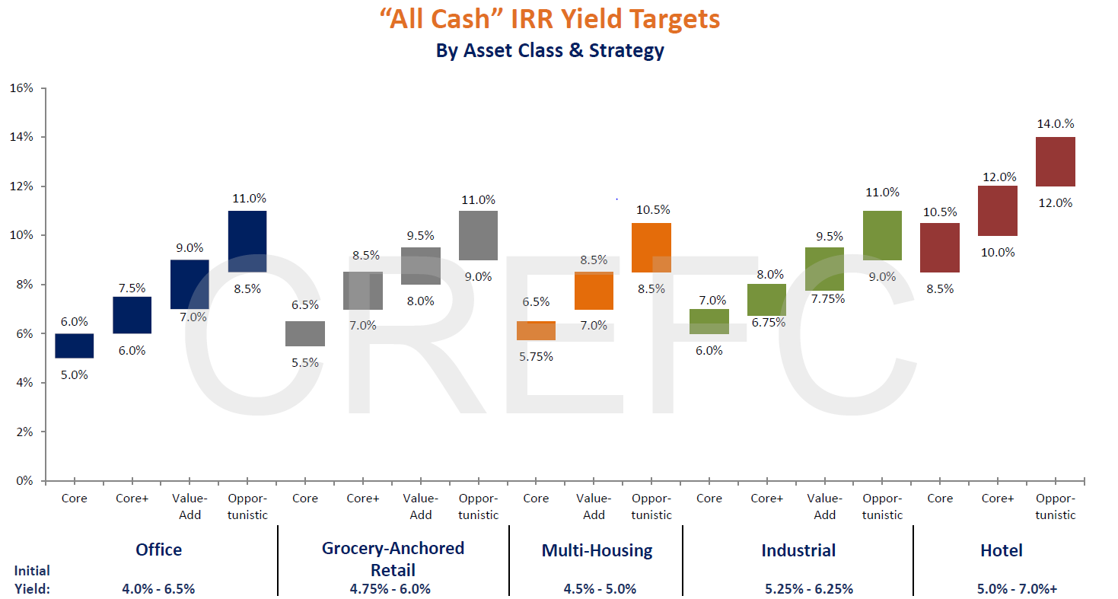
Source: Real Capital Analytics via HFF

Slide 11
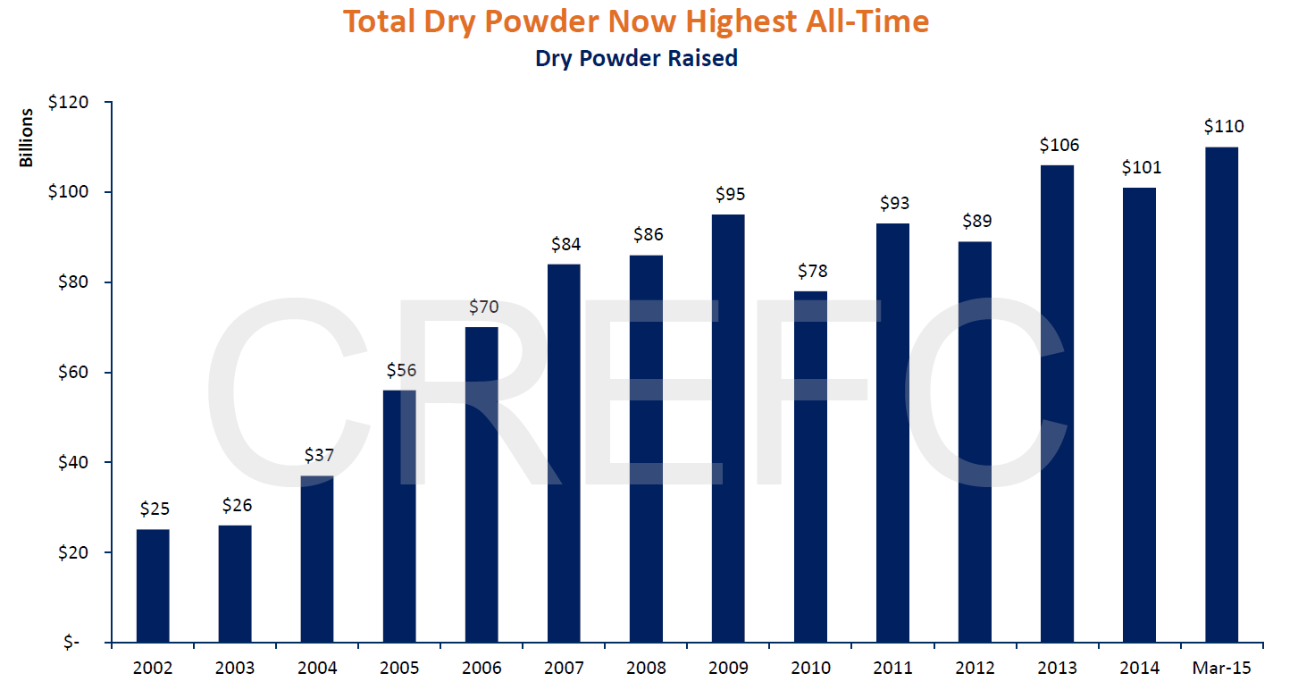
Source: Real Capital Analytics via HFF

Slide 12
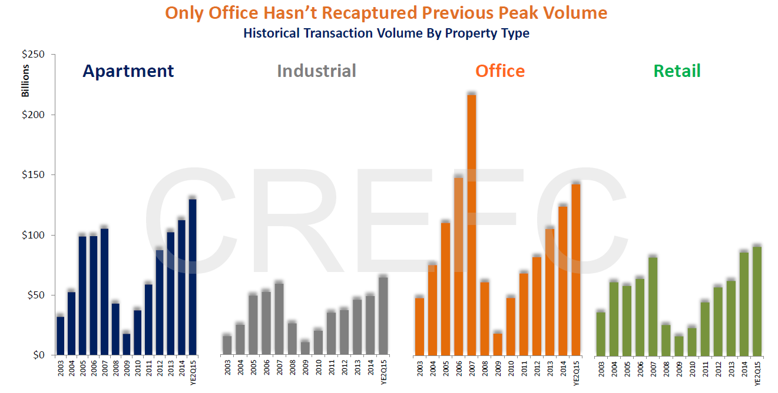
Source: Real Capital Analytics via HFF

Slide 13
Source: Real Capital Analytics via HFF

Slide 14
Source: Trepp via HFF

Slide 15
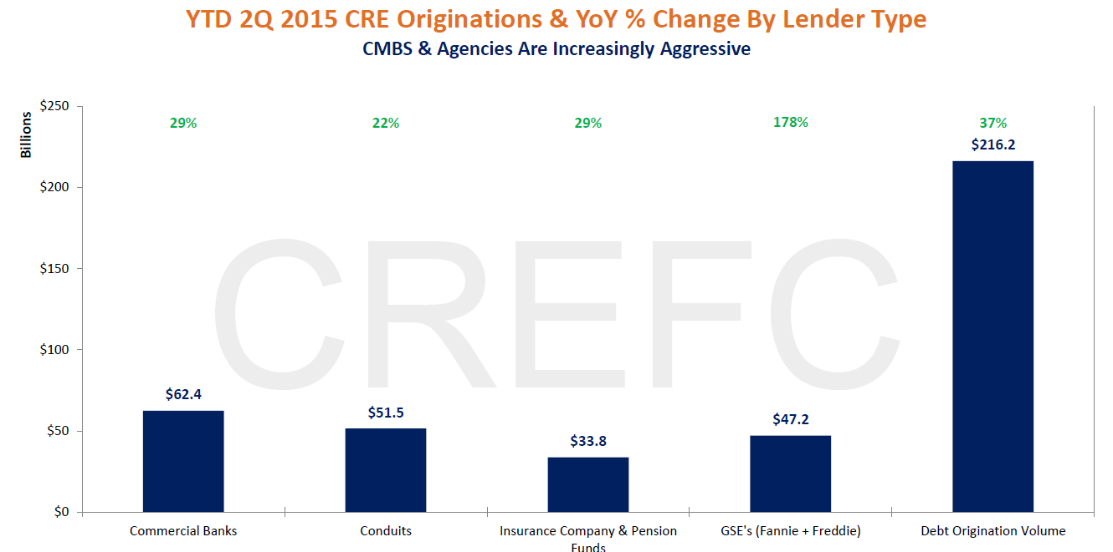
Source: Mortgage Bankers Association via HFF

Slide 16
CRE Debt Outstanding
$3.3 Trillion
Source: Federal Reserve

Slide 17
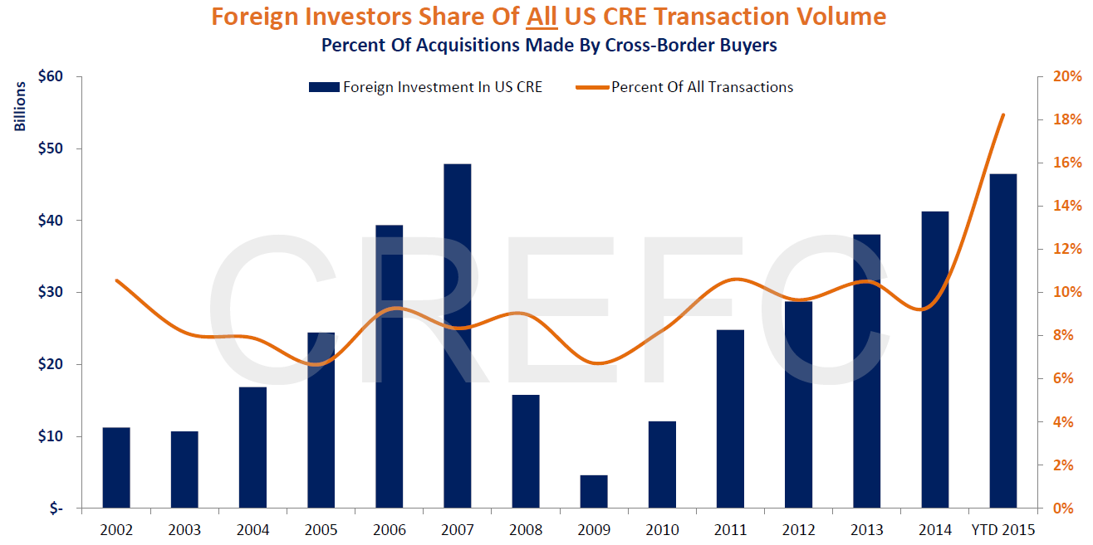
Source: Real Capital Analytics via HFF

Slide 18
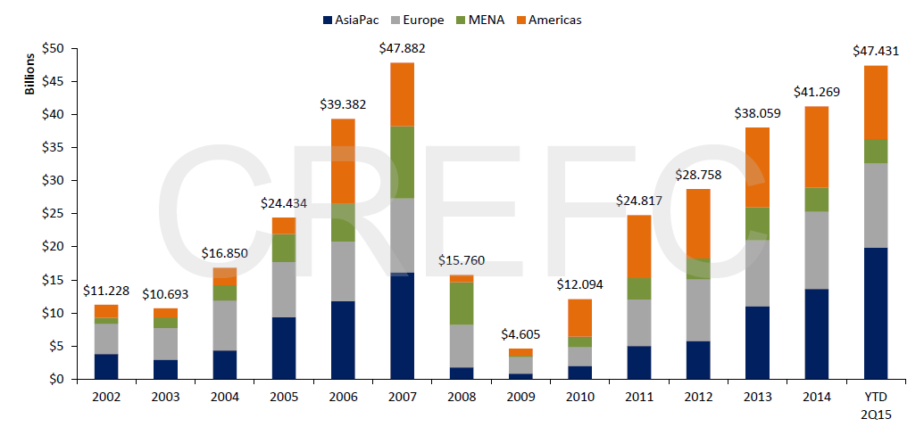
2Q 2015 Foreign Investment Exceeds YE2014 Total
Surge In Asian Influence Continues
Source: Real Capital Analytics via HFF

Slide 19
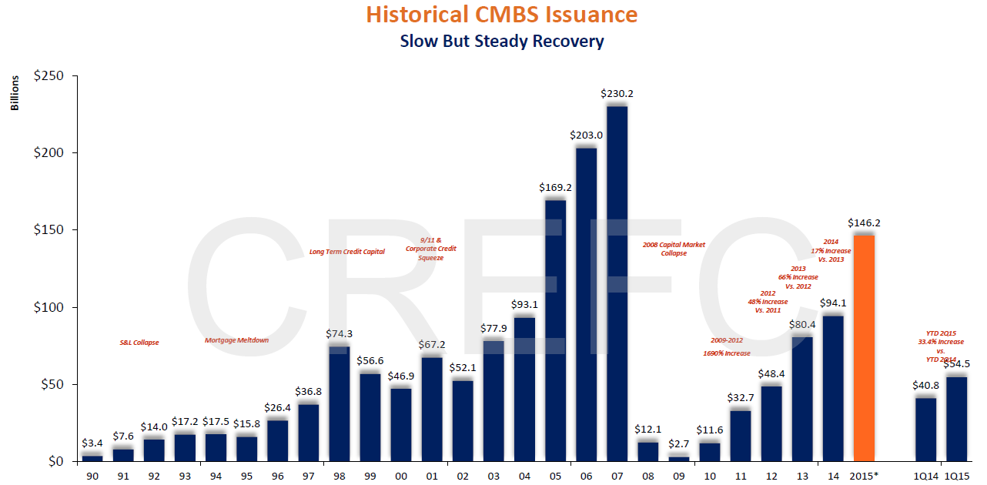
Source: Commercial Real Estate Direct, CMA via HFF

Slide 20
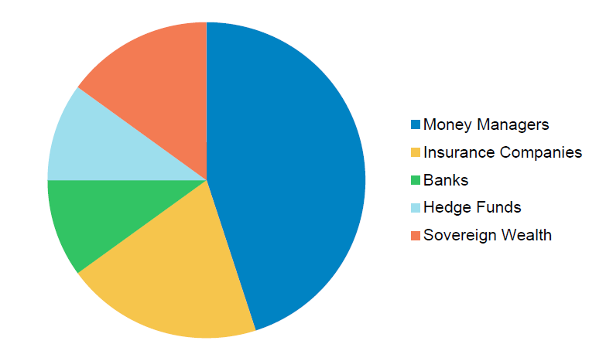
Investor Composition of New Issue CMBS
More Than Half Composed Of Money Managers/Insurance Companies 19 B-Piece Buyers In 2014 vs. 11 In 2007
15%
10%
45%
10%
20%
Source: Morgan Stanley, Jefferies

Slide 21
Source: ACLI, MBA via HFF

Slide 22
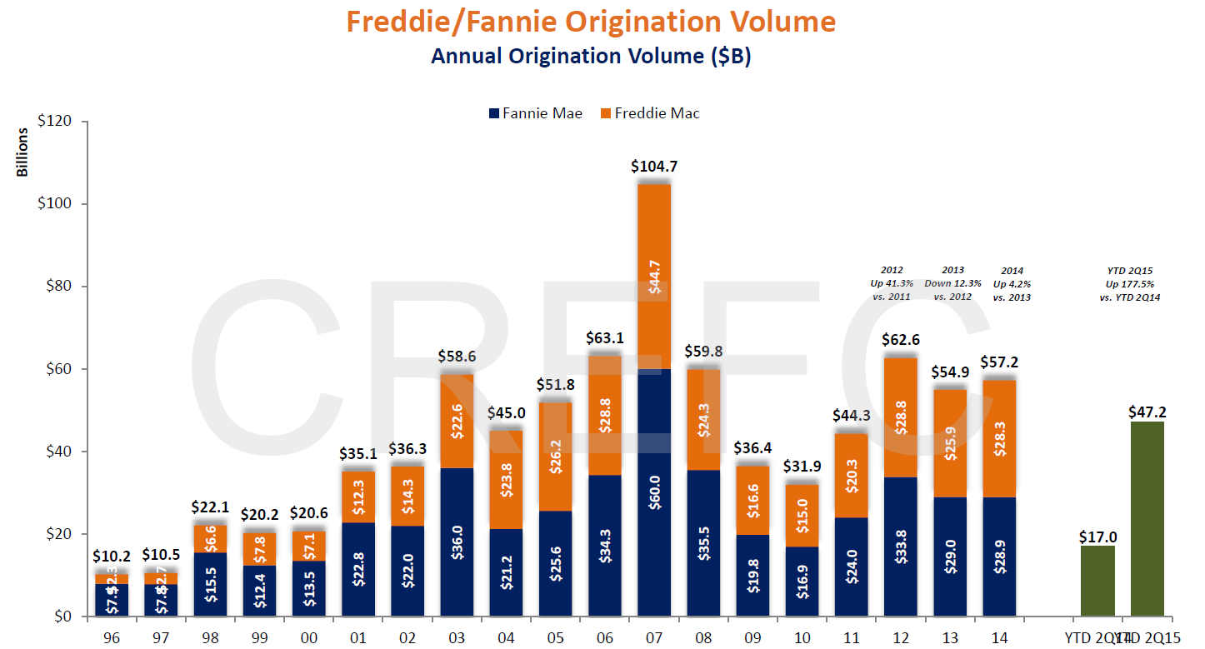
Source: Real Capital Analytics via HFF

Slide 23
The Regulatory Environment Is Shifting Market Share
Banks Hit Hard By Regs; Non-Bank Lenders Gaining Market Share
Basel III
Regulation AB II/Risk Retention
Volcker Rule Compliance
Liquidity Coverage Ratio
HVCRE

Slide 24
CREFC Paper: Impact of Regulation on CRE Finance
Conclusion: Regulation is a Blunt Instrument.
Goal of most regulations is to wring risk out of the system.
Regulation can shift risk but has not been found to reliably reduce it.
Monetary policy is a markedly better tool than regulation in achieving behavior modification and, ultimately, risk reduction.
Regulation has so far been ineffective in improving underwriting standards.

Slide 25
CREFC Paper: Impact of Regulation on CRE Finance
Regulation will add an estimated 10 – 100 basis points of cost to a loan or bond.
Costs to borrowers is estimated to drive economic activity downward by an estimated $209 billion over ten years.
In some cases, regulation is leading to worsening standards and outcomes.
Regulatory complexity makes it more difficult to make longer-term decisions.

Slide 26
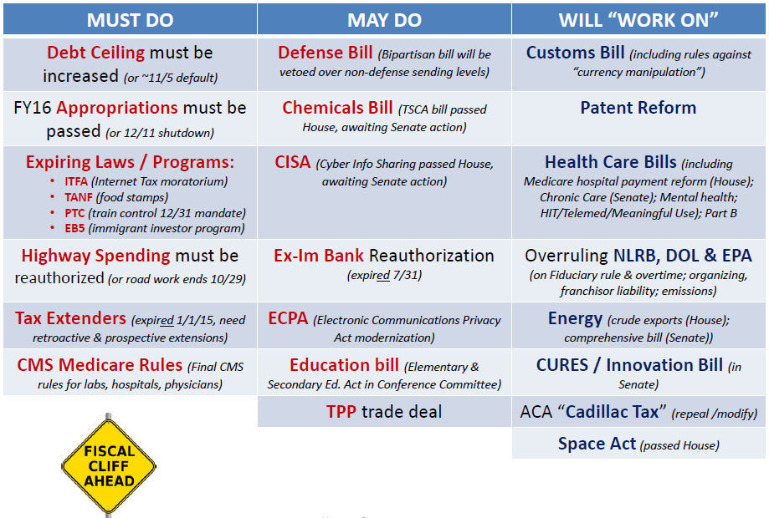
Congress…Much Left To Do in Q4

Slide 27
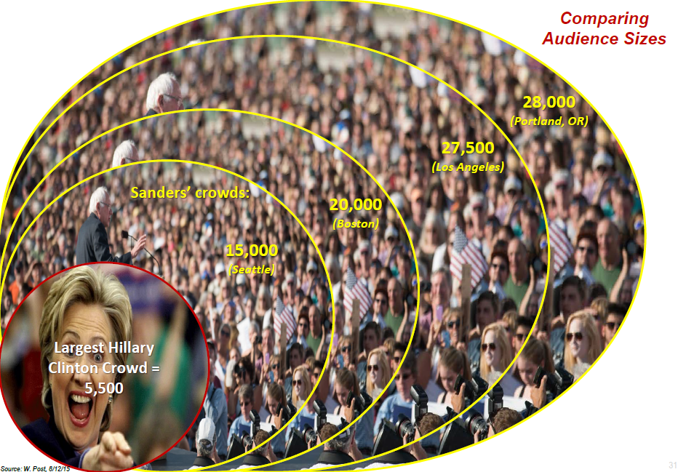
Some Voting With Their Feet…

Slide 28
Mitt’s 2012 Mistakes = Trump’s 2016 Triumphs

